Slide 1


Slide 2


Lesson 2:
Measurement of Speed

Slide 3
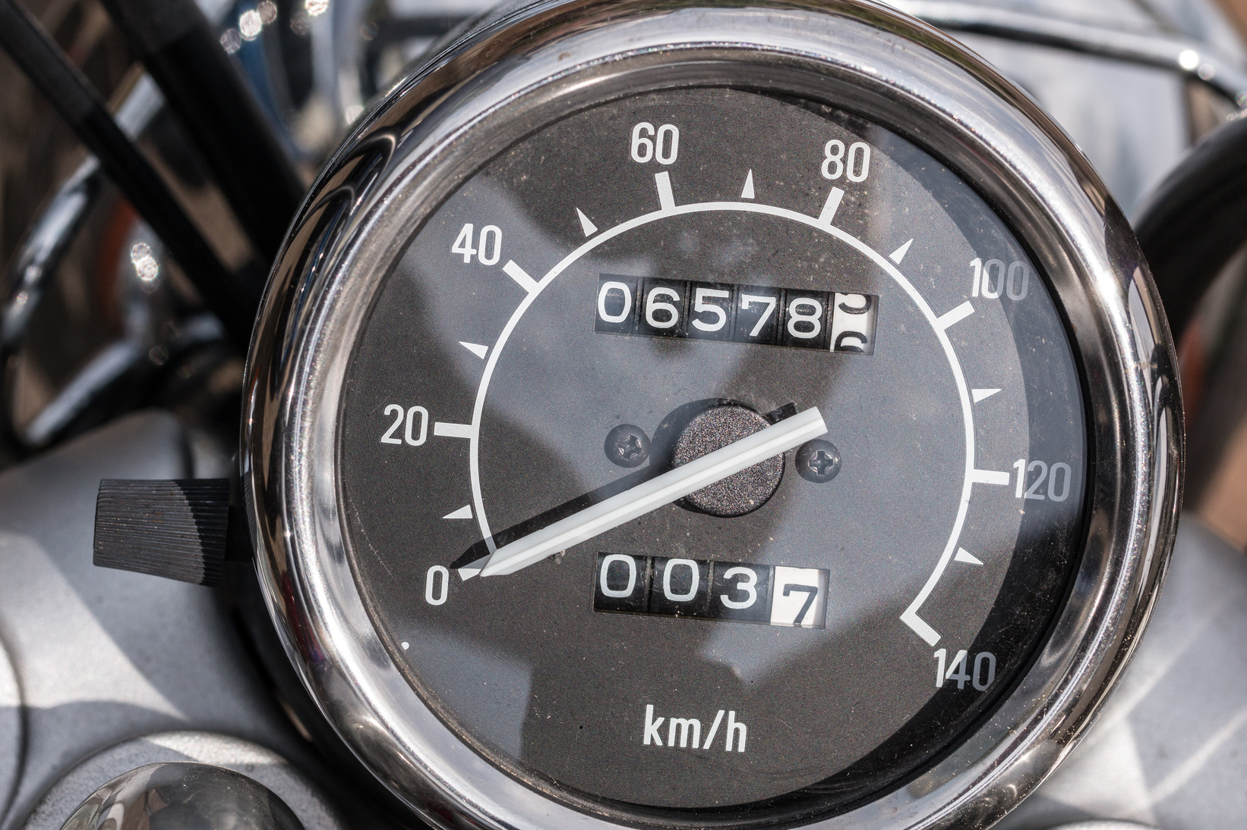
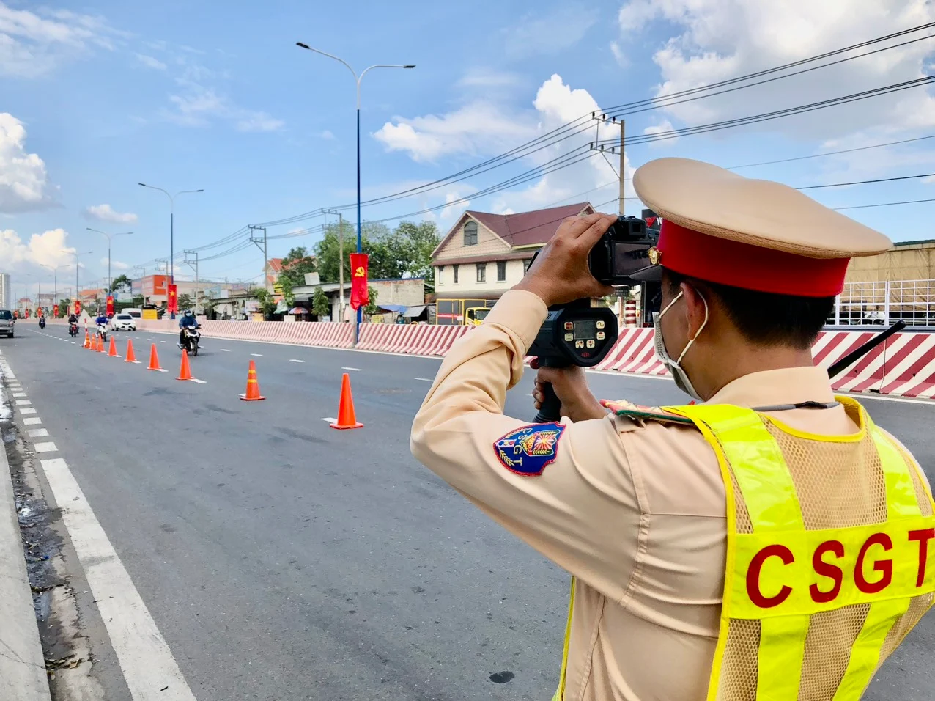
Lead-in
How can we know the speed of our motorbikes?
What do the policeman use to know the speed of our motorbikes?

Slide 4

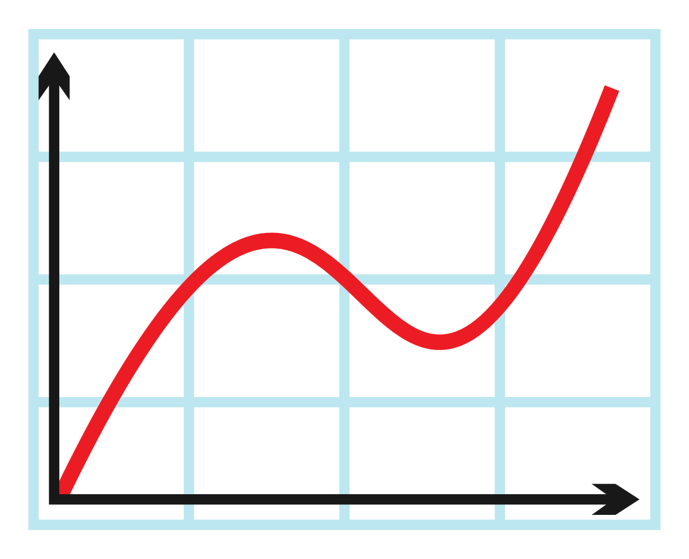
New vocabulary
graph
(n)
/ɡræf/
a picture that shows how two sets of information or variables (= amounts that can change) are related, usually by lines or curves

Slide 5
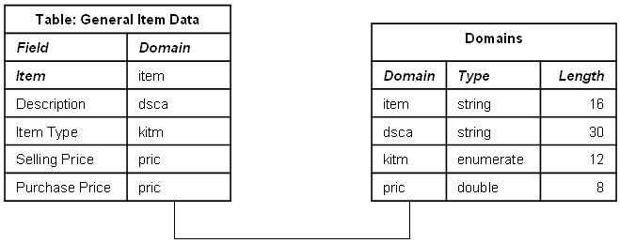
New vocabulary
table
(n)
/ˈteɪbl/
an arrangement of facts and numbers, usually in rows on a page, that makes information easy to understand.

Slide 6
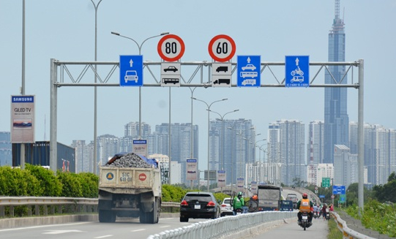
New vocabulary
limited speed
(n phr)
/ˈlɪmɪtɪd spiːd/
the maximum or minimum speed permitted by law in a given area under specified circumstances.

Slide 7
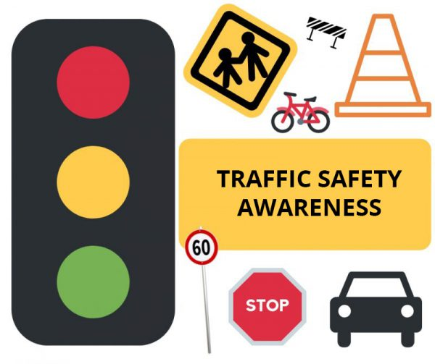
New vocabulary
traffic safety
(n phr)
/ˈtræfɪk ˈseɪfti/
teaching people how to behave safely when driving or crossing the road.

Slide 8
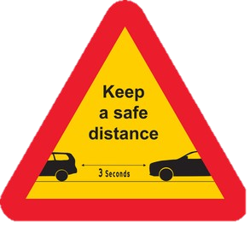
New vocabulary
safe distance
(n phr)
/seɪf ˈdɪstəns/
the minimum amount of space needed between people, vehicles, or objects to prevent accidents, ensure safety, or avoid harm

Slide 9
New vocabulary
New words | Pronunciation | Meaning
1. graph (n) | /ɡræf/ | Biểu đồ
2. table (n) | /ˈteɪbl/ | Bảng dữ liệu
3. limited speed (n phr) | /ˈlɪmɪtɪd spiːd/ | Tốc độ giới hạn
4. traffic safety (n phr) | /ˈtræfɪk ˈseɪfti/ | An toàn giao thông
5. safe distance (n phr) | /seɪf ˈdɪstəns/ | Khoảng cách an toàn

Slide 10
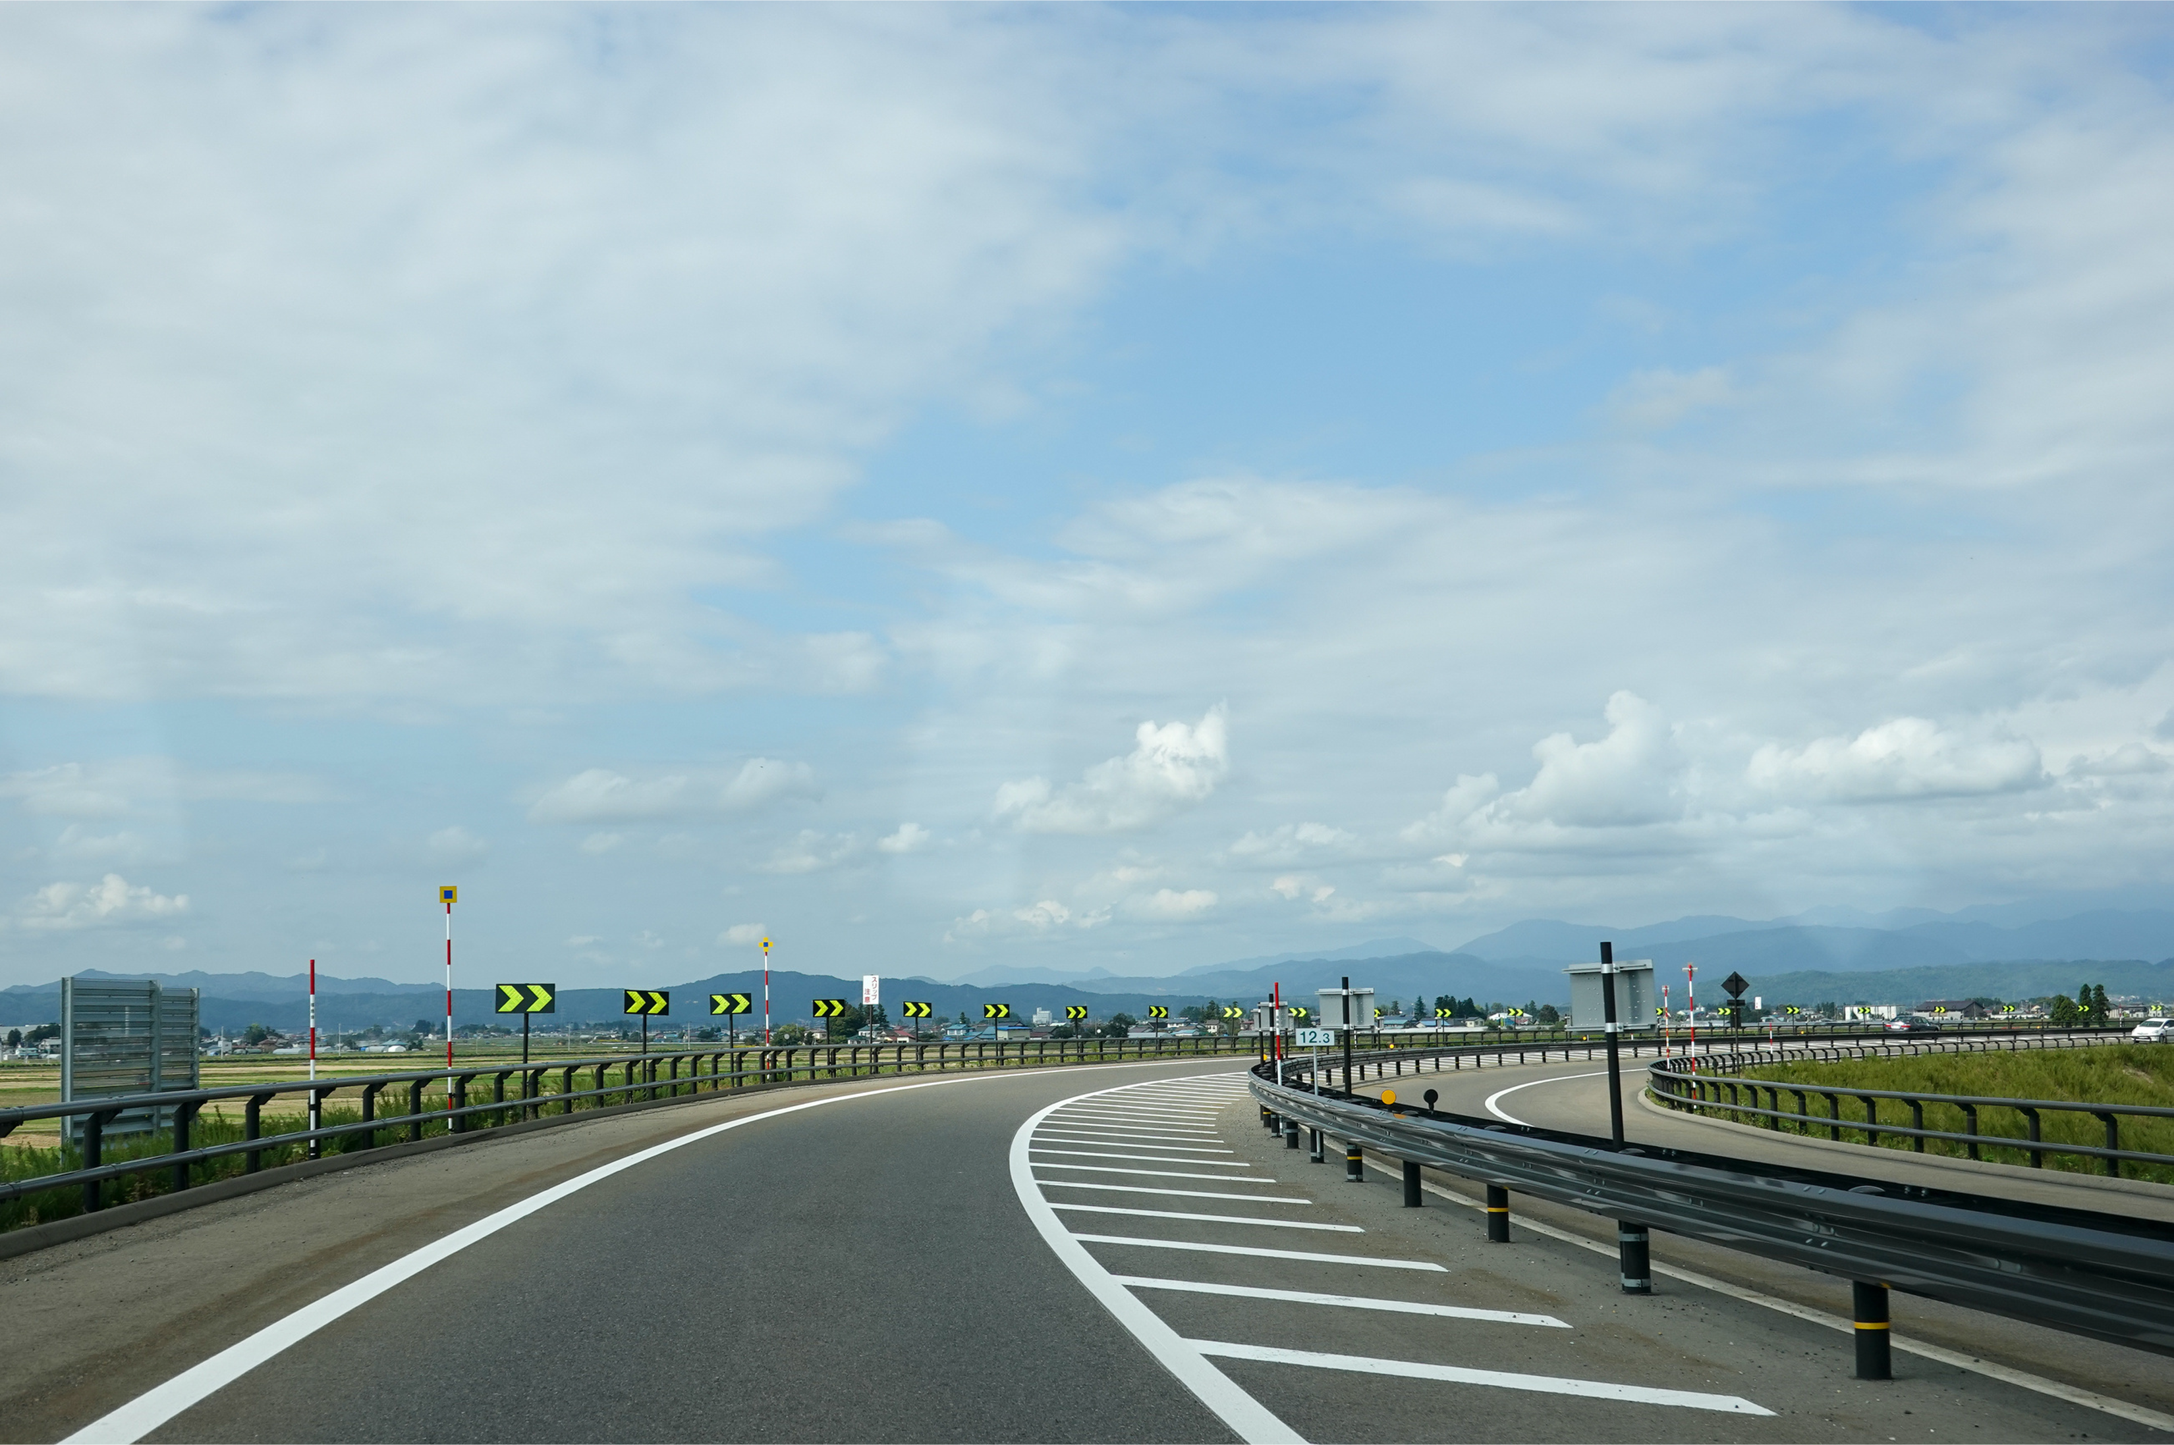
Practice
limited speed
safe distance
traffic safety

Slide 11
Practice
Limited speed
graph
safe distance

Slide 12
Practice
safe distance
traffic safety
limited speed

Slide 13
Practice
graph
safe distance
table

Slide 14
Practice
limited speed
traffic safety
safe distance

Slide 15
Practice
(P. 24) Read the paragraph and answer the questions below.
Traffic situations are very complicated these days, so we need to follow traffic safety regulations, especially safe distance and speed limit. To do this, we should notice signs on the roads and drive our vehicles at the speed lower than the speed limit in that region. For example, people should remember the “3-second rule” when driving on highways: safe distance (m) = speed (m/s) x 3 (s). Keeping a safe distance from the vehicles ahead gives drivers time to react when those vehicles have any trouble. We should keep at least three to four seconds of distance in normal conditions, and even more in bad weather or heavy traffic. Doing this keeps drivers safe because they can avoid hitting other vehicles. Also, it helps traffic flow better and lowers the risk of many accidents at the same time.

Slide 16
Practice
(P. 24) Read the paragraph and answer the questions below.
Traffic situations are very complicated these days, so we need to follow traffic safety regulations, especially safe distance and speed limit. To do this, we should notice signs on the roads and drive our vehicles at the speed lower than the speed limit in that region. For example, people should remember the “3-second rule” when driving on highways: safe distance (m) = speed (m/s) x 3 (s). Keeping a safe distance from the vehicles ahead gives drivers time to react when those vehicles have any trouble. We should keep at least three to four seconds of distance in normal conditions, and even more in bad weather or heavy traffic. Doing this keeps drivers safe because they can avoid hitting other vehicles. Also, it helps traffic flow better and lowers the risk of many accidents at the same time.
What simple rule helps us keep a safe distance?
A. 2-second rule
B. 3-second rule
C. 4-second rule

Slide 17
Practice
(P. 24) Read the paragraph and answer the questions below.
Traffic situations are very complicated these days, so we need to follow traffic safety regulations, especially safe distance and speed limit. To do this, we should notice signs on the roads and drive our vehicles at the speed lower than the speed limit in that region. For example, people should remember the “3-second rule” when driving on highways: safe distance (m) = speed (m/s) x 3 (s). Keeping a safe distance from the vehicles ahead gives drivers time to react when those vehicles have any trouble. We should keep at least three to four seconds of distance in normal conditions, and even more in bad weather or heavy traffic. Doing this keeps drivers safe because they can avoid hitting other vehicles. Also, it helps traffic flow better and lowers the risk of many accidents at the same time.
b. Why is it important to keep a safe distance? (you can choose more than one option)
A. Not to hit the cars in front
B. Help traffic flow better
C. Increase the number of accidents.

Slide 18
Practice
(P. 24) Read the paragraph and answer the questions below.
Traffic situations are very complicated these days, so we need to follow traffic safety regulations, especially safe distance and speed limit. To do this, we should notice signs on the roads and drive our vehicles at the speed lower than the speed limit in that region. For example, people should remember the “3-second rule” when driving on highways: safe distance (m) = speed (m/s) x 3 (s). Keeping a safe distance from the vehicles ahead gives drivers time to react when those vehicles have any trouble. We should keep at least three to four seconds of distance in normal conditions, and even more in bad weather or heavy traffic. Doing this keeps drivers safe because they can avoid hitting other vehicles. Also, it helps traffic flow better and lowers the risk of many accidents at the same time.
c. In bad weather, the safe distance from other vehicles should be:
A. 3 seconds
B. 4 seconds
C. 5 seconds
D. 6 seconds

Slide 19

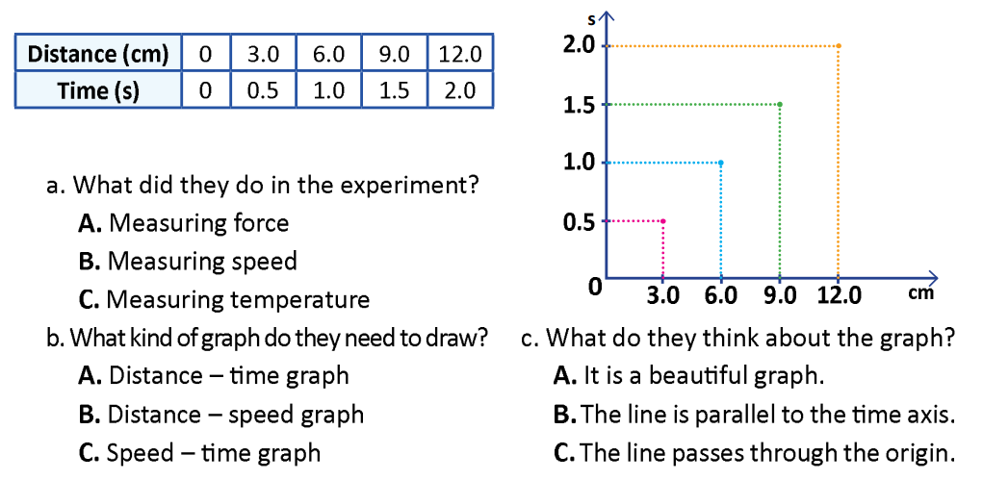
Practice
(P. 25) Listen to the conversation and choose the correct answer

Slide 20
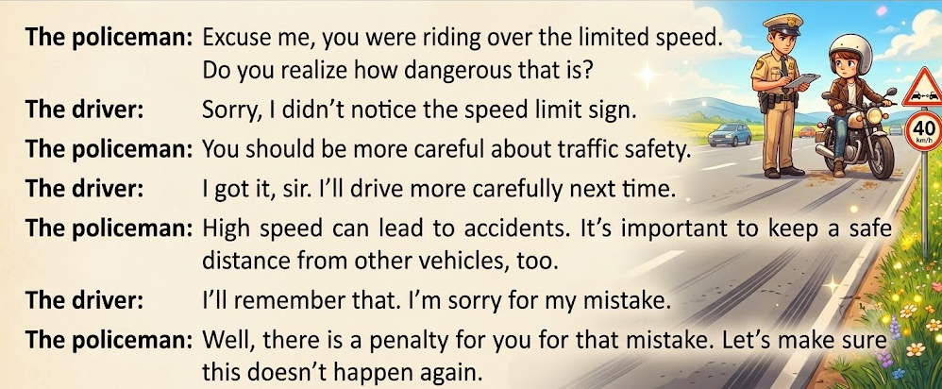
Practice
(P. 24) Speaking
Imagine a traffic policeman caught a driver for driving too fast. Make a conversation between the policeman and the driver as in the following example:

Slide 21
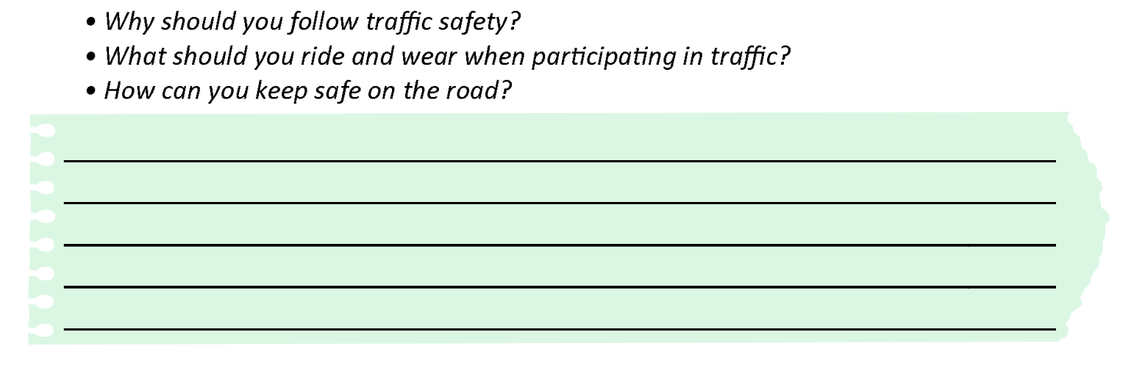
Produce
Homework
(P. 25) Write a short paragraph (50-60 words) to guide 7th grade students on traffic safety.

Slide 22
Consolidation
- Vocabulary: graph, table, limited speed, traffic safety, safe distance.
Understand and do exercises, related to measurement of speed.
Prepare the next lesson.

Slide 23




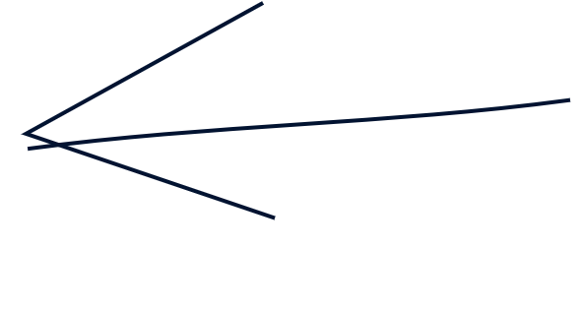


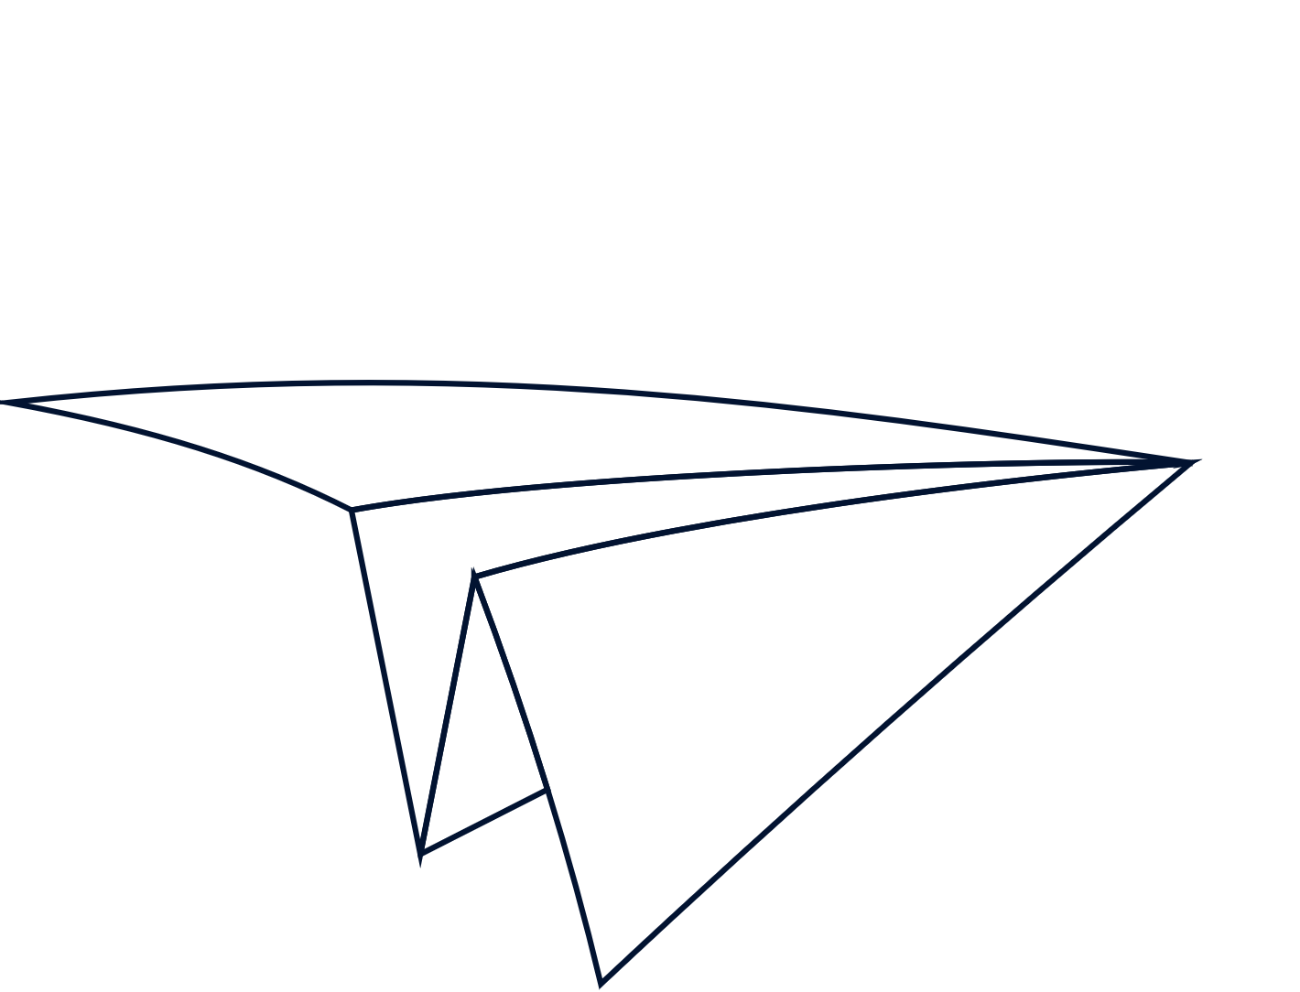
“Energy cannot be created or destroyed; transform yours into action.”

